Slide 1

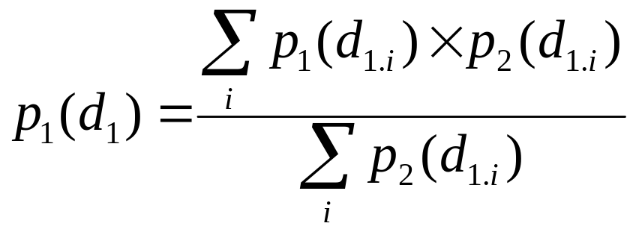
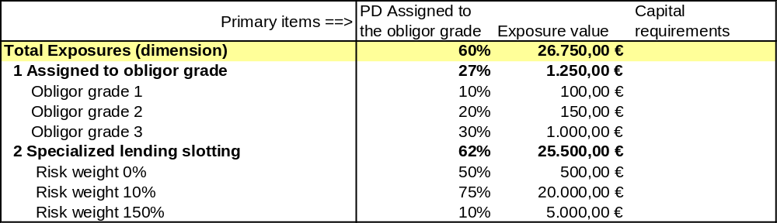
COREP Use case 18: Weighted average of member children
Weighted average of its dimensional children
by another primary item

Slide 2
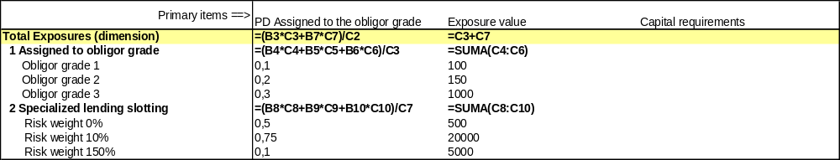
Weighted average of member children
Excel formulas:
Make PD controlling fact, get PD and EV of dimensional children
General variable for PDxEV member matching

Slide 3
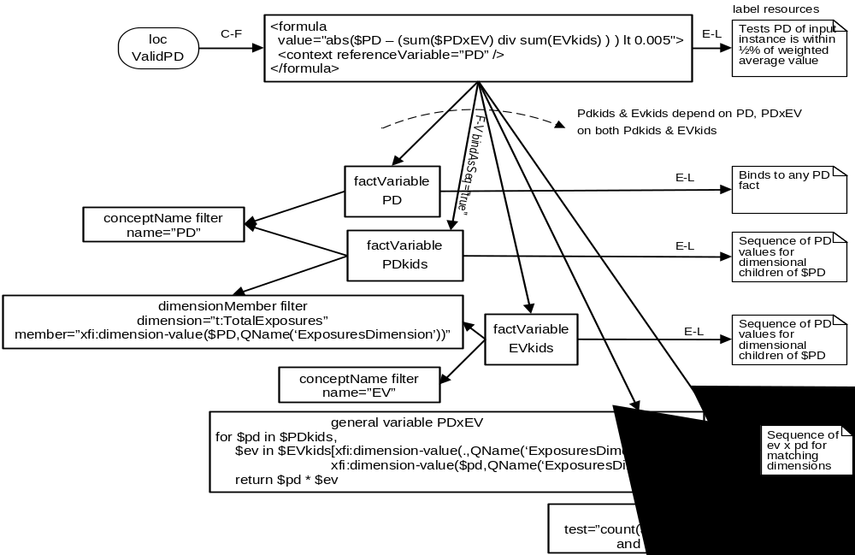
Weighted average of member children

